Slide 1
Recurrent Neural Network
计86 周恩贤

Slide 2
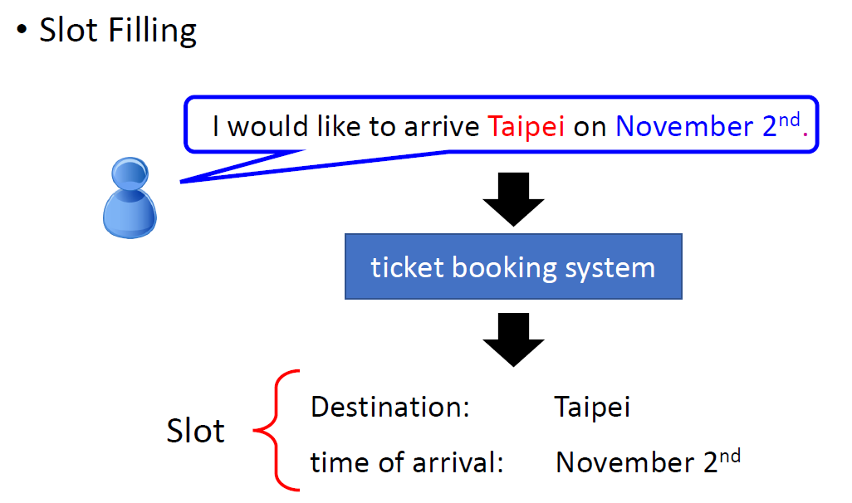
Limits of NN

Slide 3
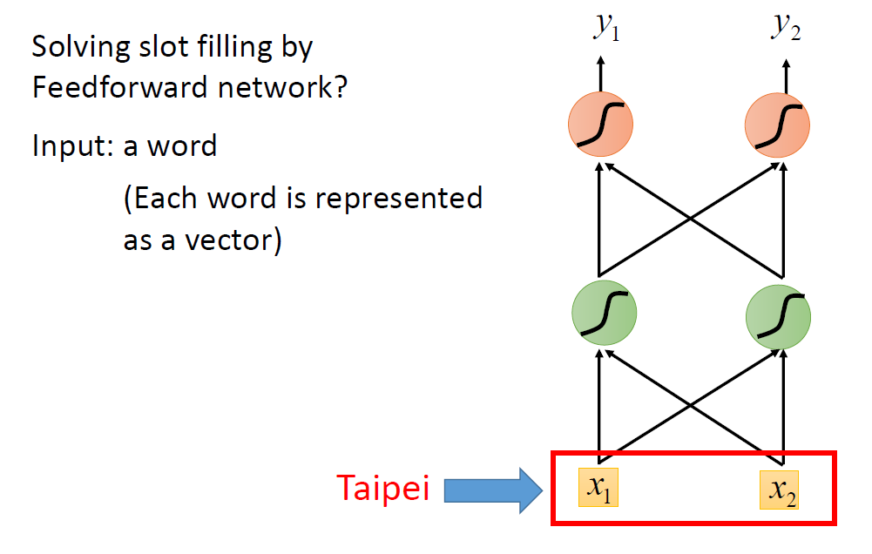
Limits of NN

Slide 4
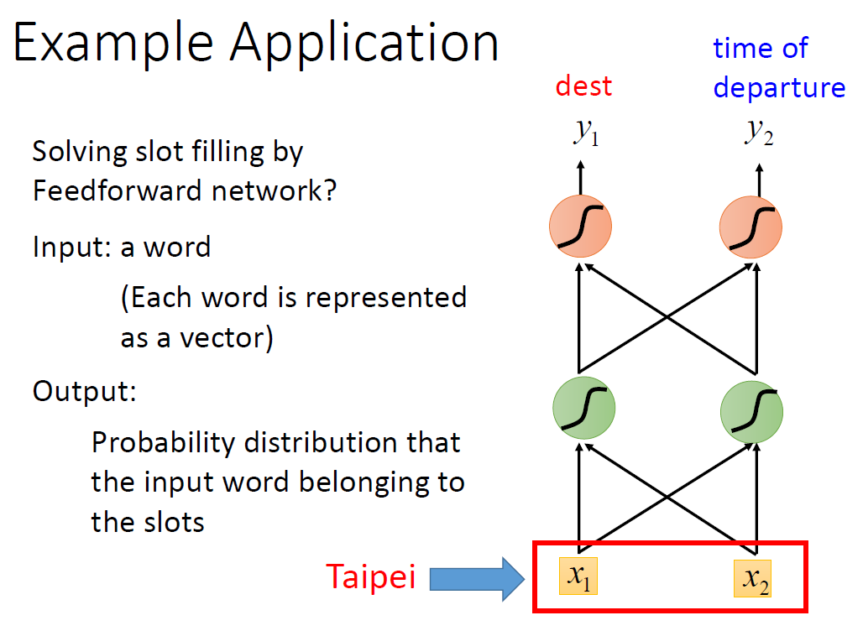
Limits of NN

Slide 5
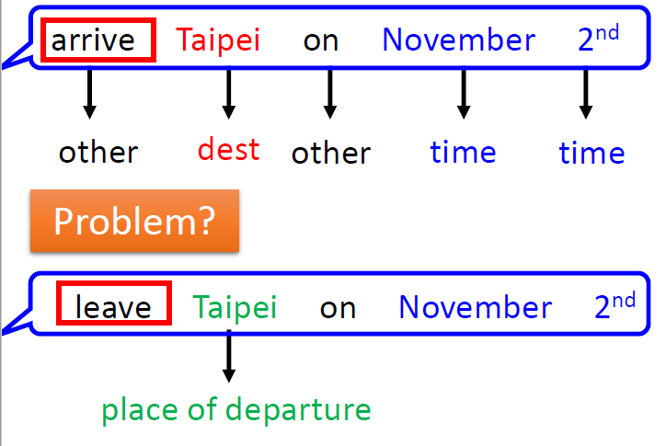

Limits of NN
NN : Same Input Words = Same Output
Same Input, Different Output ?

Slide 6
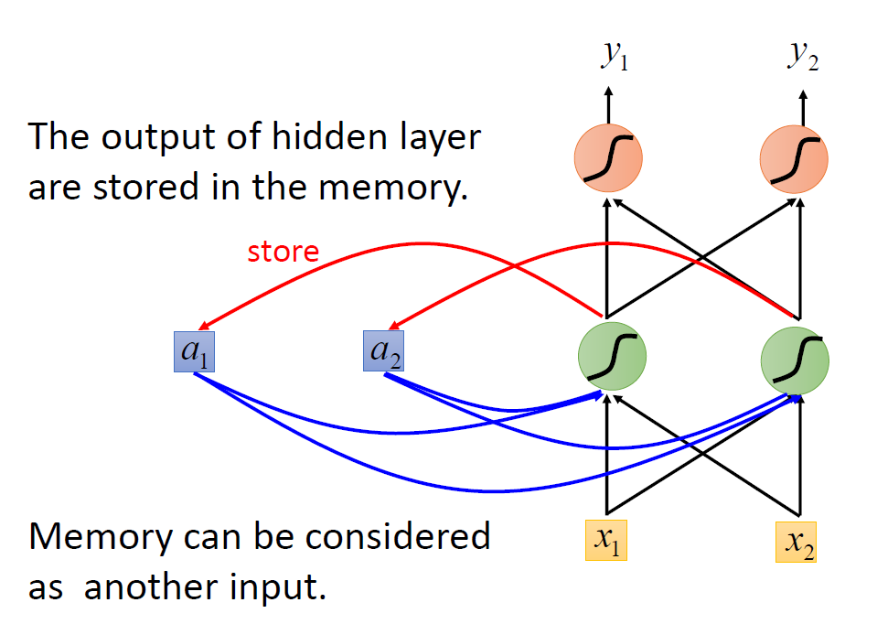
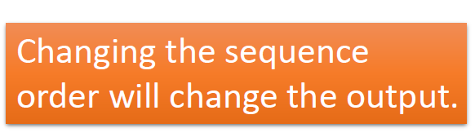
Recurrent Neural Network (RNN)
v.s CNN –
Permutation in same kernel
won’t influence the feature map.

Slide 7
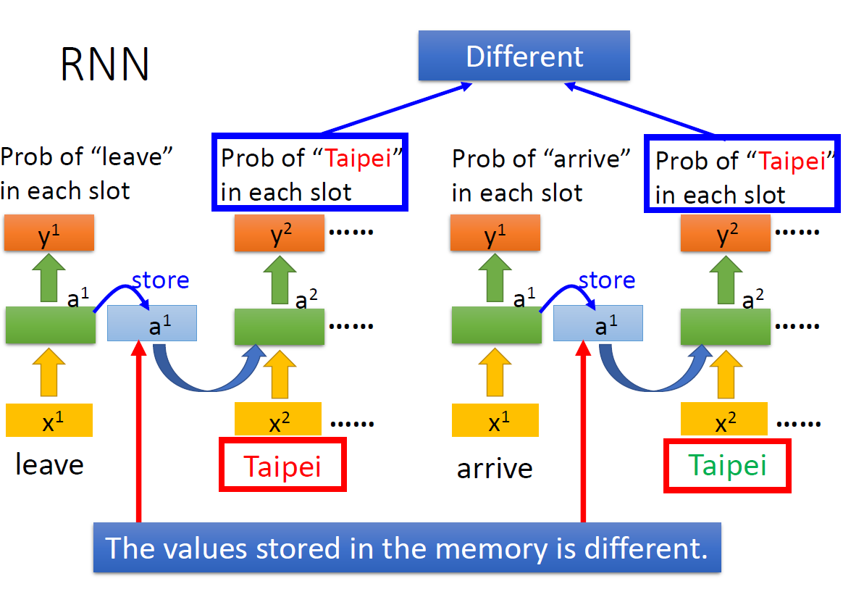

Slide 8
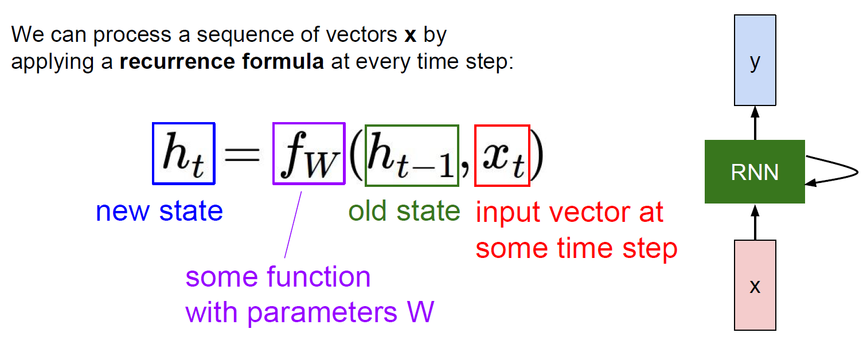
RNN
Notice: the same function and the same set
of parameters are used at every time step !!!

Slide 9
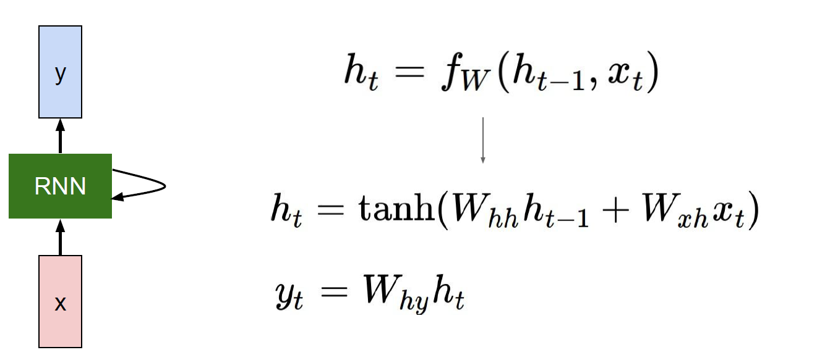
Vanilla RNN

Slide 10
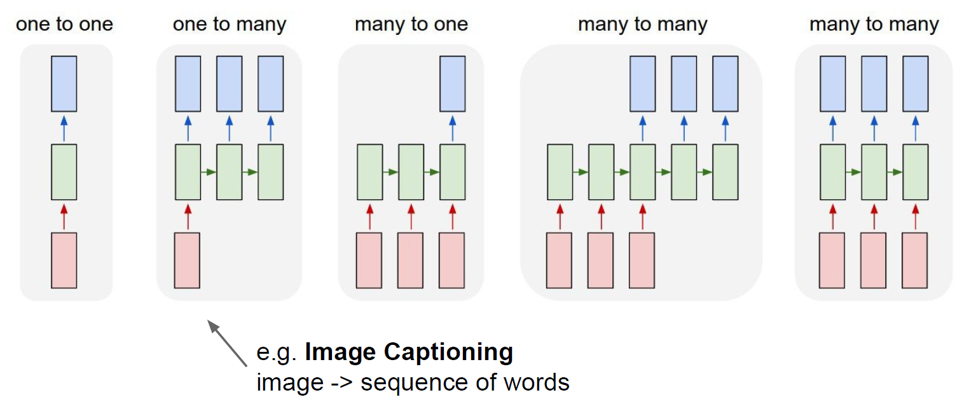
RNN : Process Sequences

Slide 11
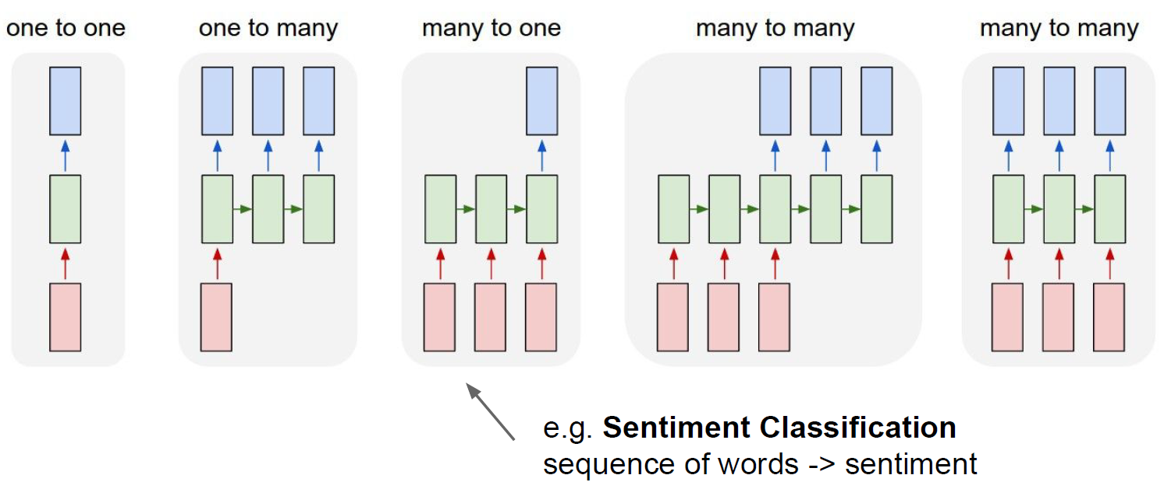
RNN : Process Sequences

Slide 12
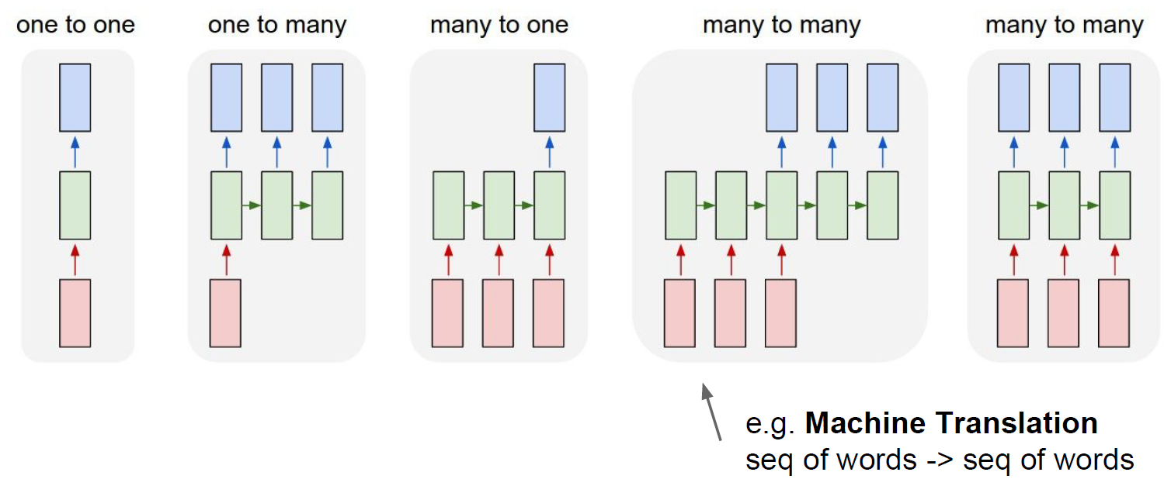
RNN : Process Sequences

Slide 13
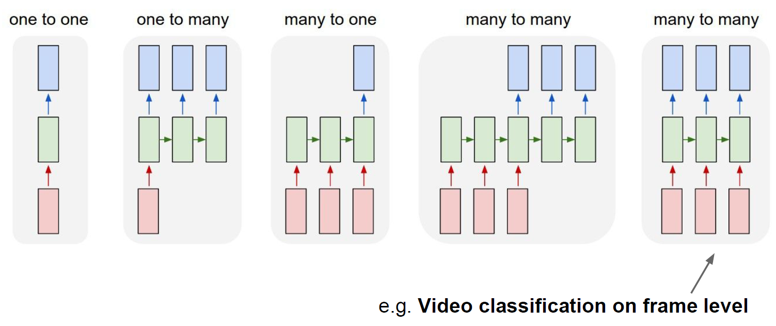
RNN : Process Sequences

Slide 14
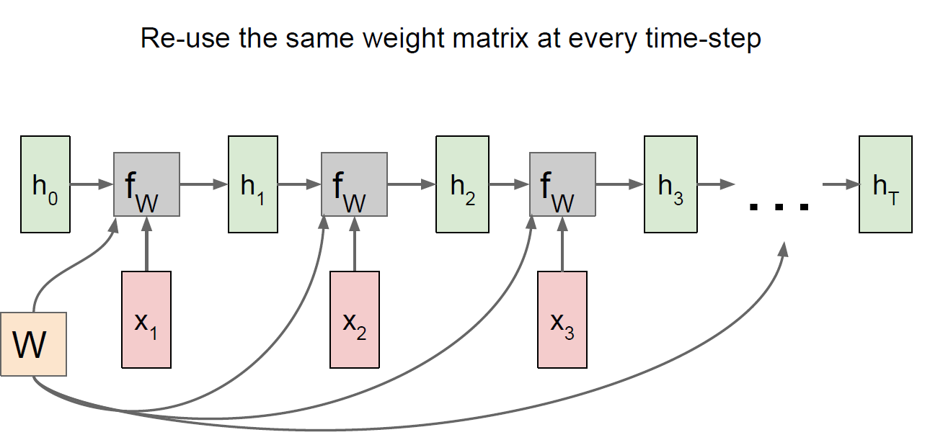
Computational Graph

Slide 15
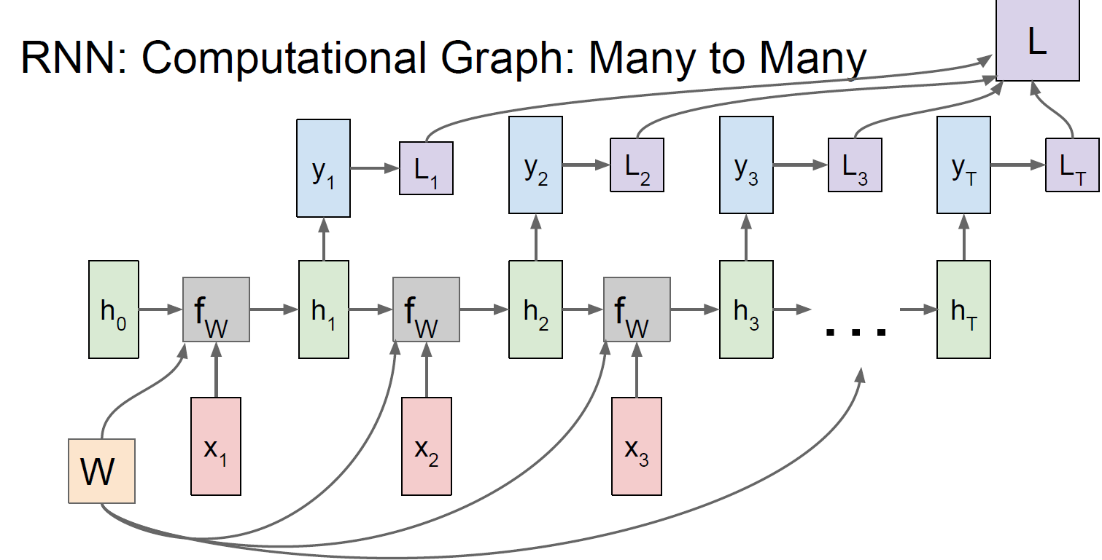

Slide 16
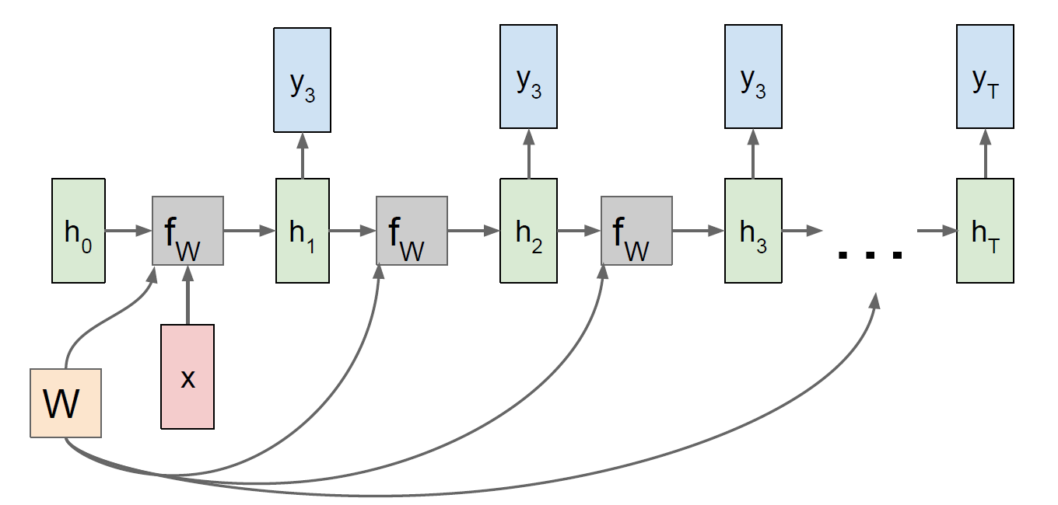
Computational Graph : One to many

Slide 17
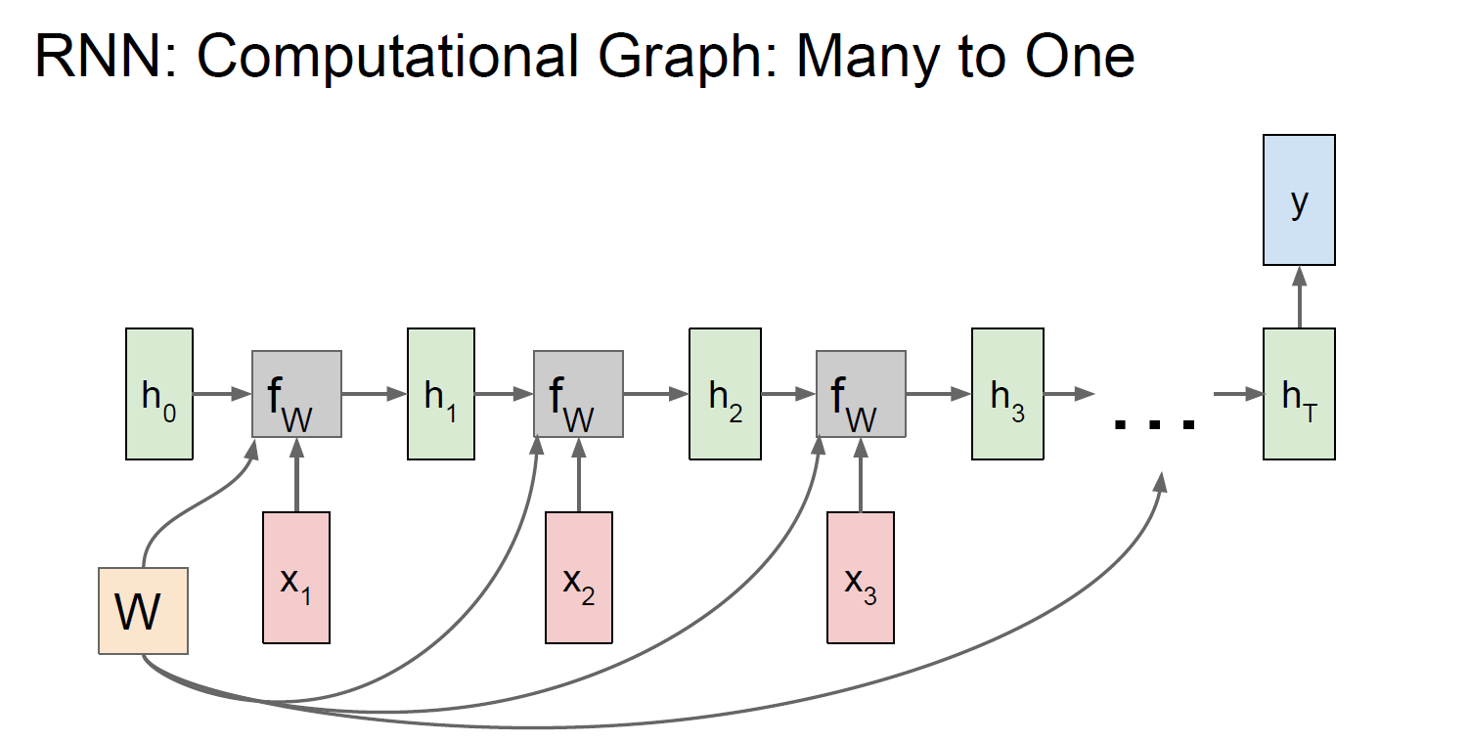

Slide 18
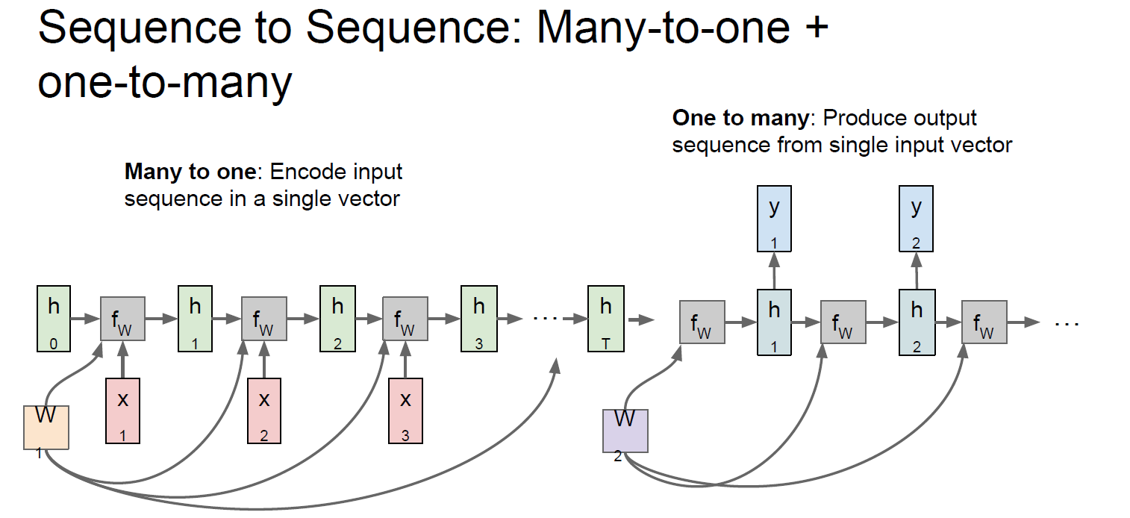
Encoder-Decoder Model (Seq2Seq)

Slide 19
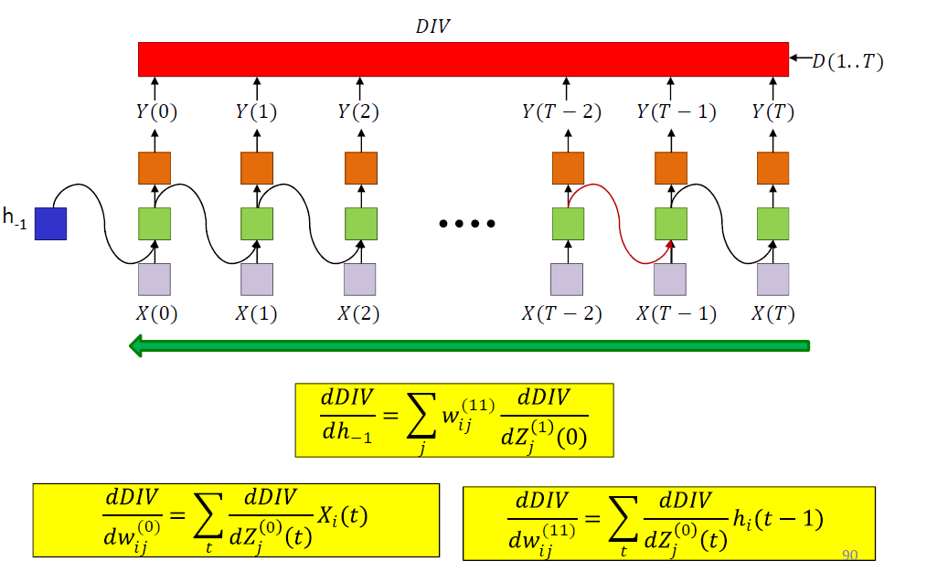
Training : Back Prop. Through Time (BPTT)
Notes:
Z(1)(t) is the pre-activation value of the neurons at the output layer at time t
Z(0)(t) is the pre-activation value of the hidden layer at time t

Slide 20
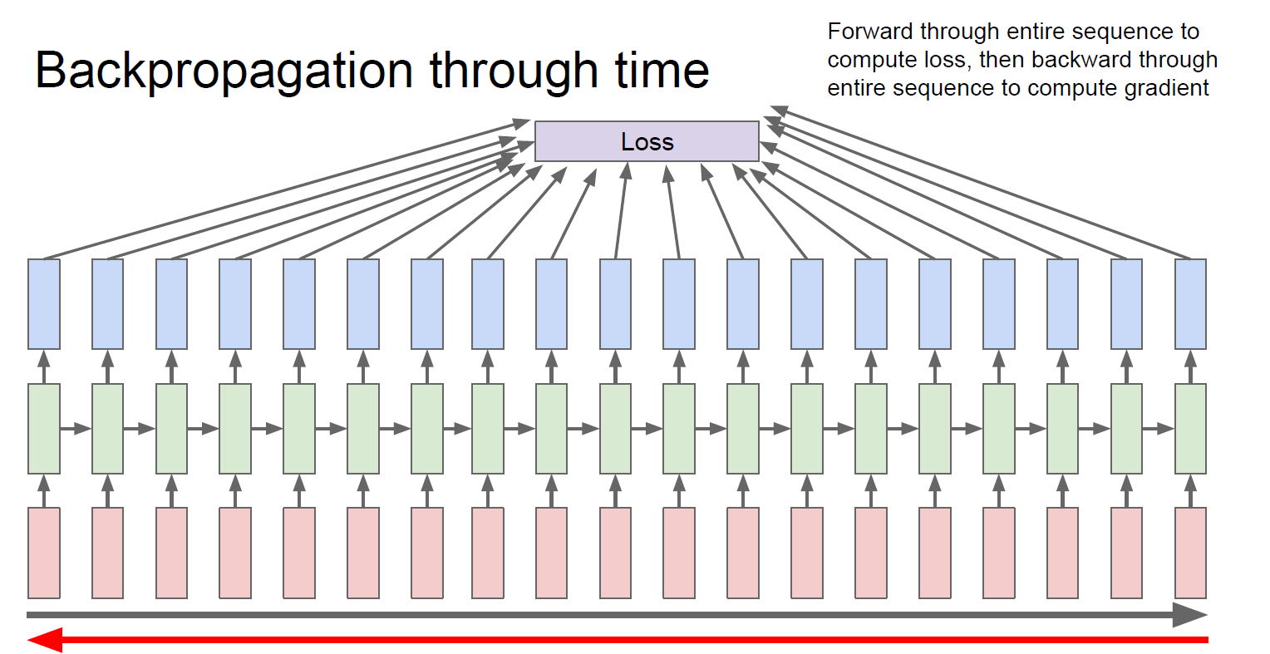
Too Costy ? Recall SGD…

Slide 21
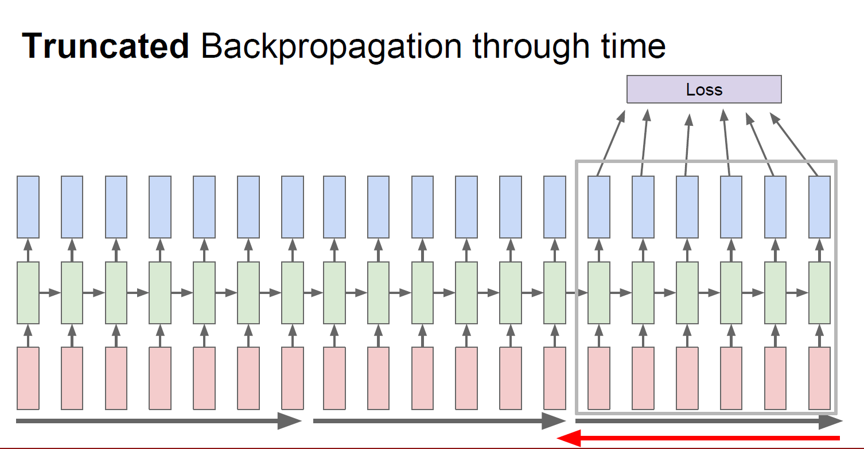
Run forward and backward through chunks of the sequence instead of whole sequence
Carry hidden states forward in time forever, but only BP for some smaller number of steps

Slide 22
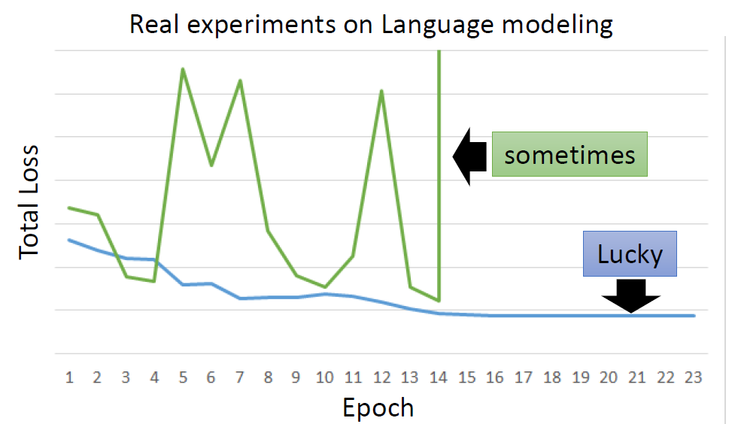
However… RNN is hard to train ?

Slide 23
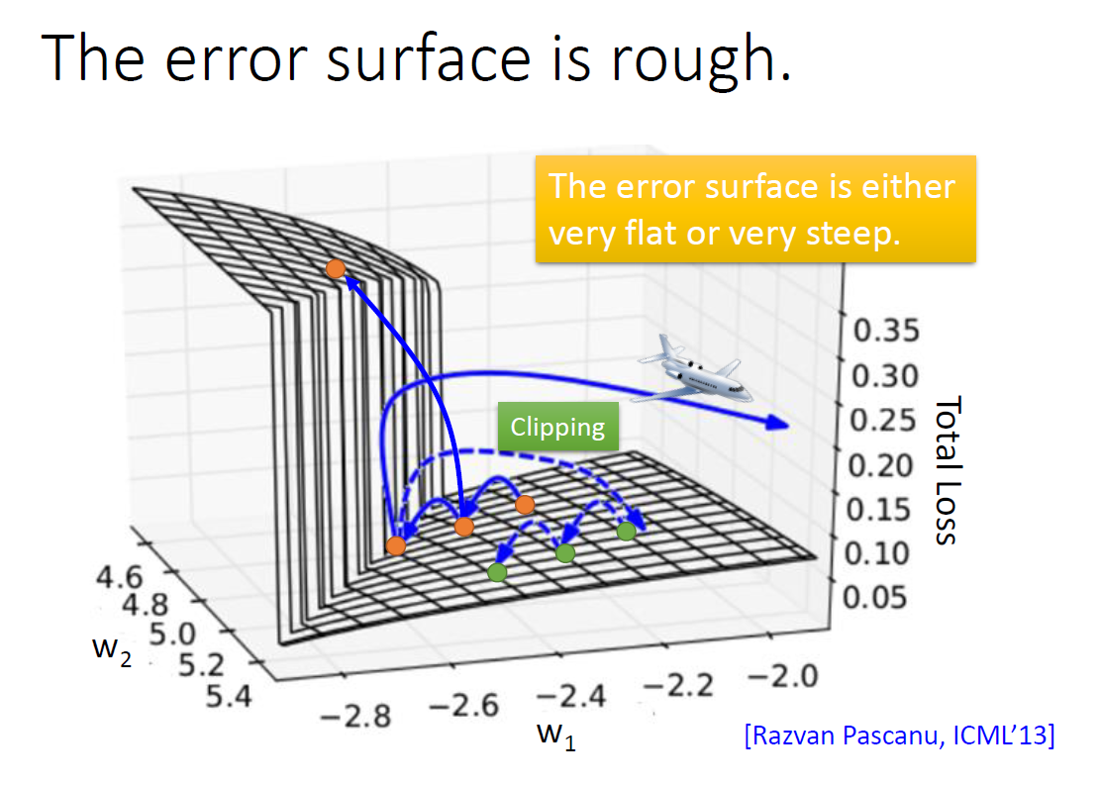
Notes:
Clipping :
if |gradient|> T => gradient = T/|gradient| * T
Recall Gradient Vanish – sigmoid ?

Slide 24
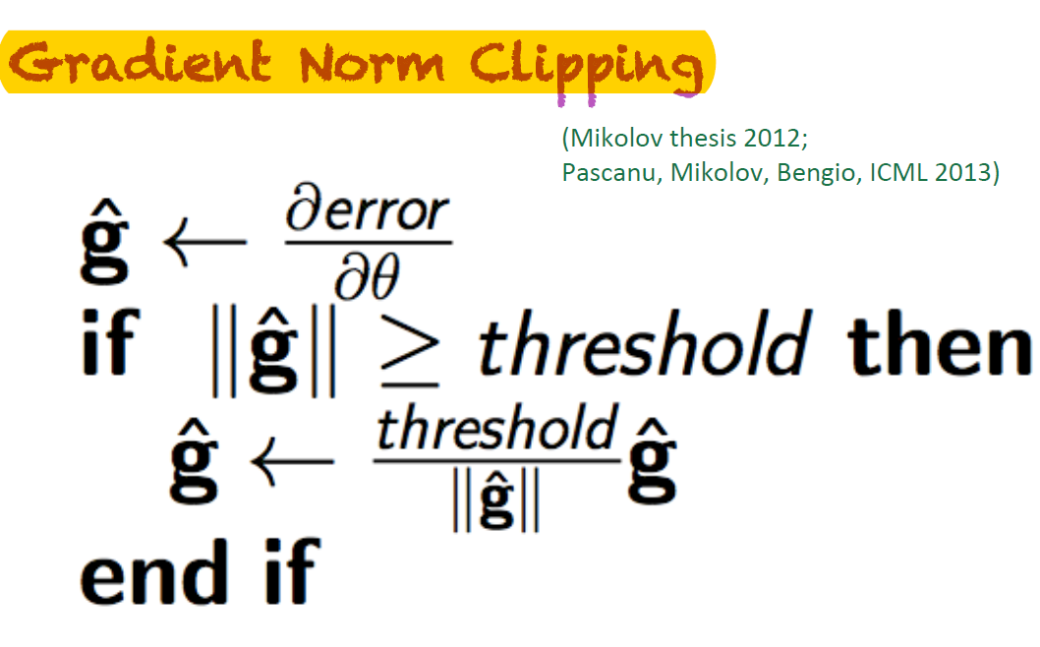
TIP

Slide 25
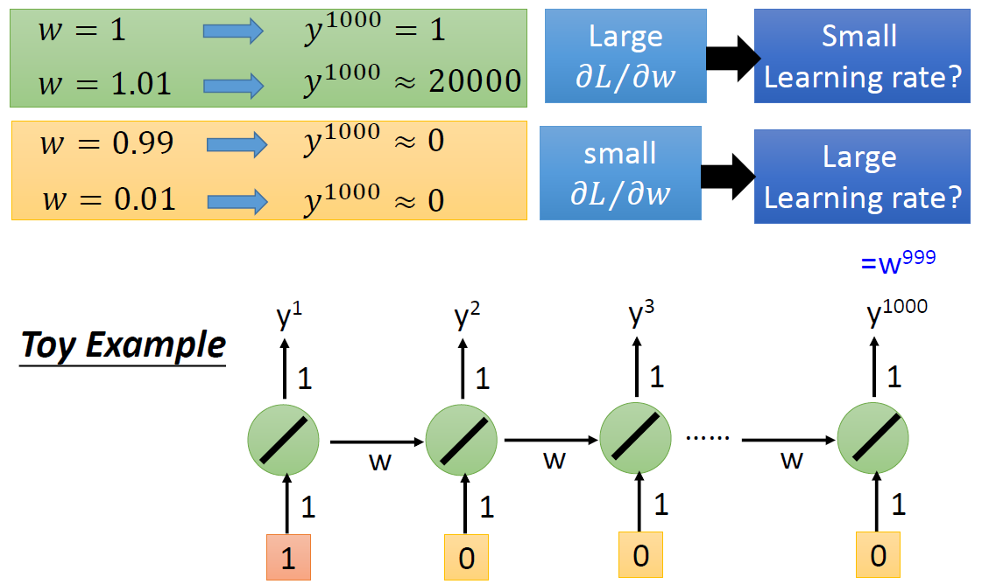
Recall BPTT: Consider an easy model…
Notes:
Gradient => 改变参数对Loss的影响有多大 ?
关键在于同样的网络被反复使用。
w即使改变一点点, 但是在不同时间点反复被使用, 叠加效应起来很大

Slide 26
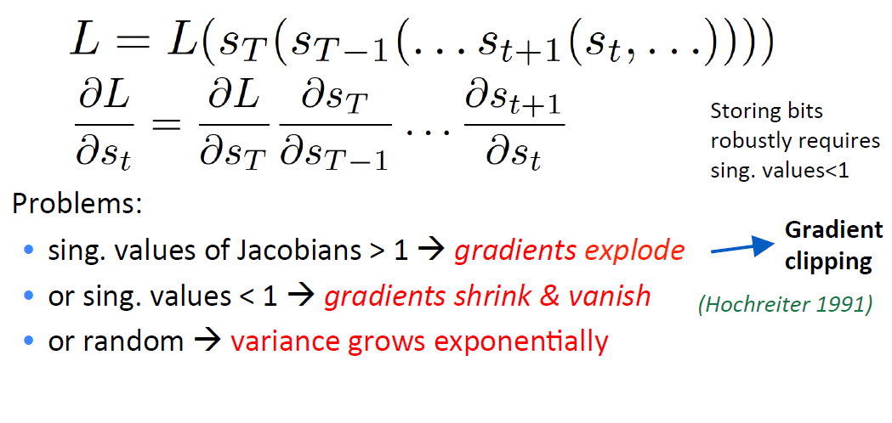
Problem of traditional RNN
Notes:
sing. values 奇异值

Slide 27
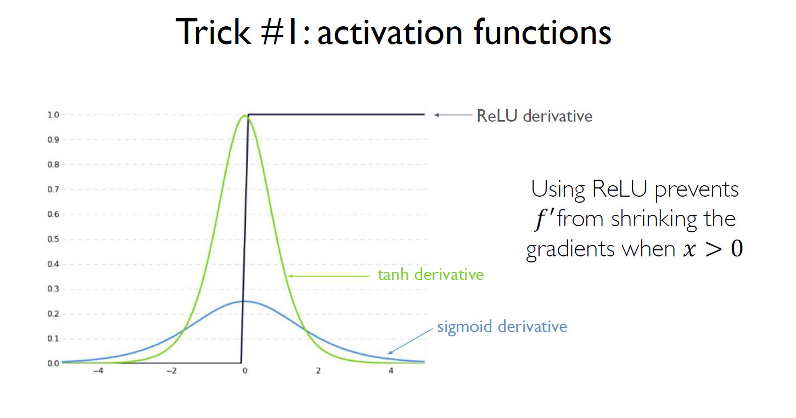

Slide 28
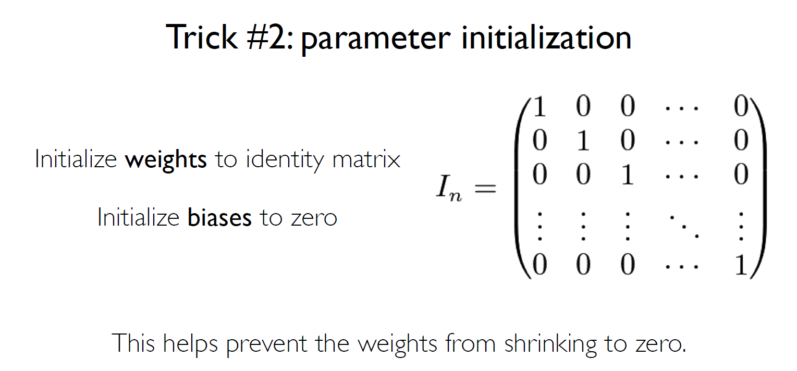

Slide 29
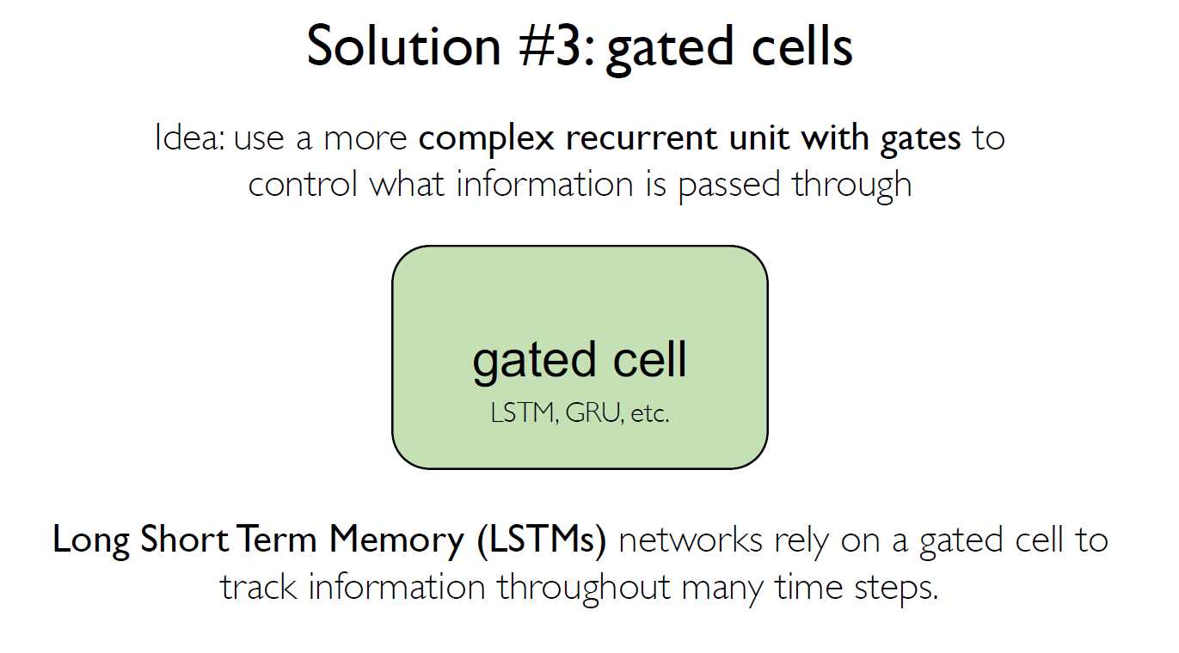

Slide 30
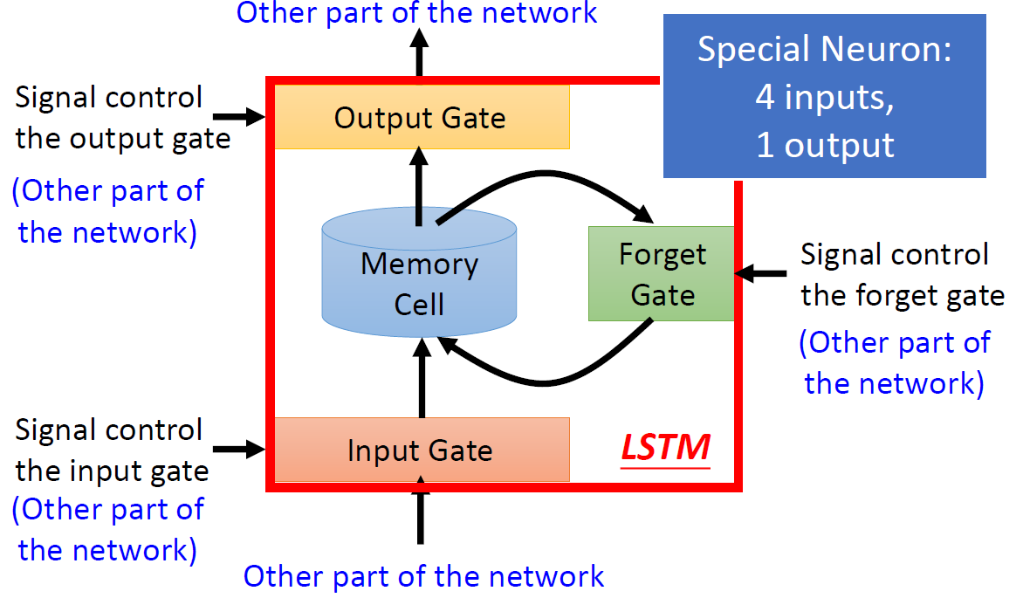
Long Short Term Memory (LSTM)
Notes:
Input vector into 4 transformation

Slide 31
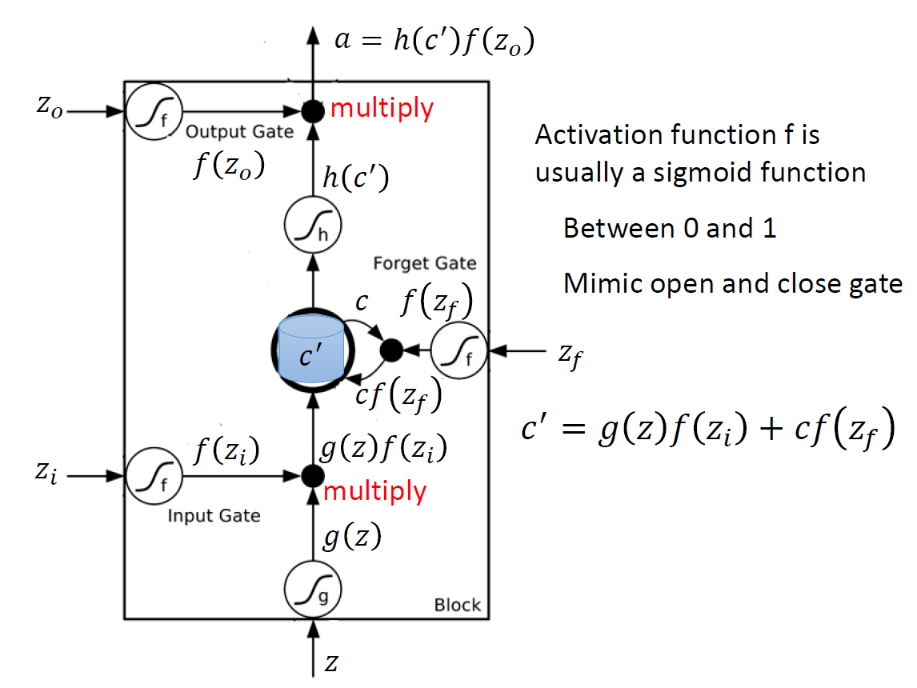
Notes:
forget gate : 0 == 开 (memory被遗忘) , 1==关 (保留memory)
usually use g , h = tanh, f = sigmoid

Slide 32
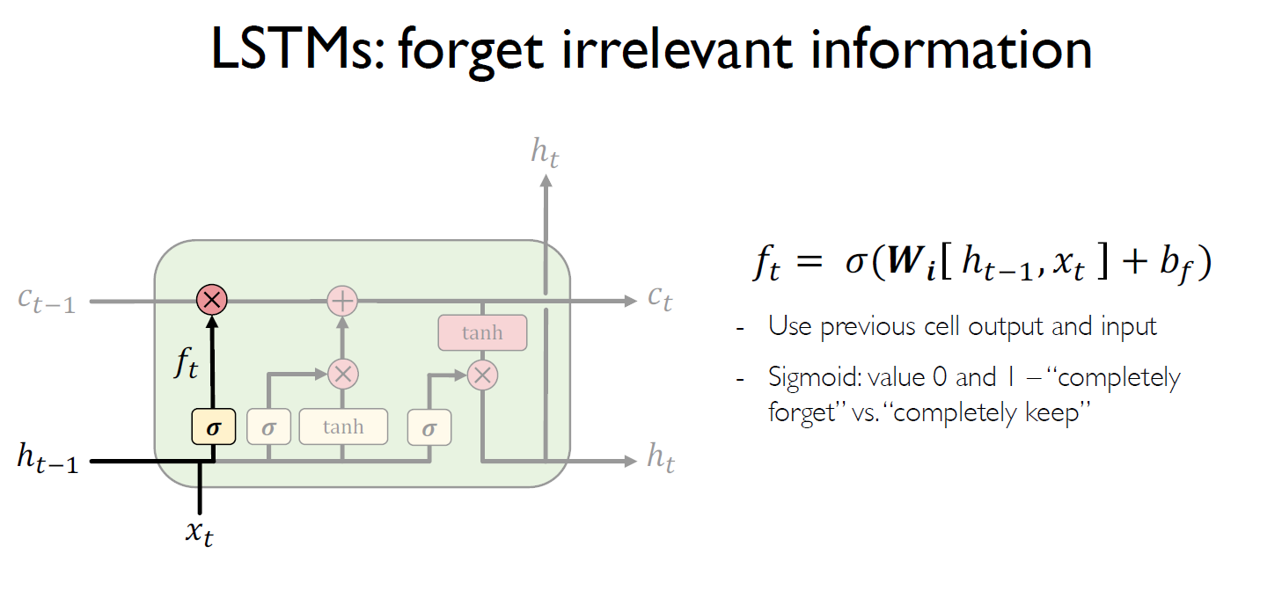
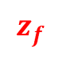
$$z_{f}$$

Slide 33
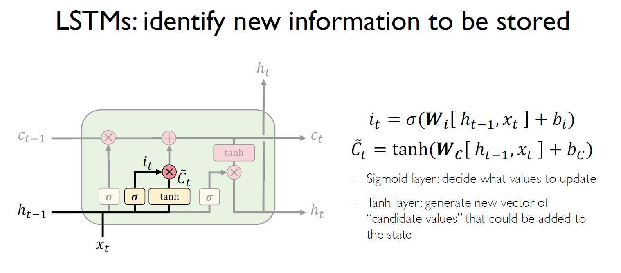
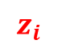
$$z_{i}$$
z

Slide 34
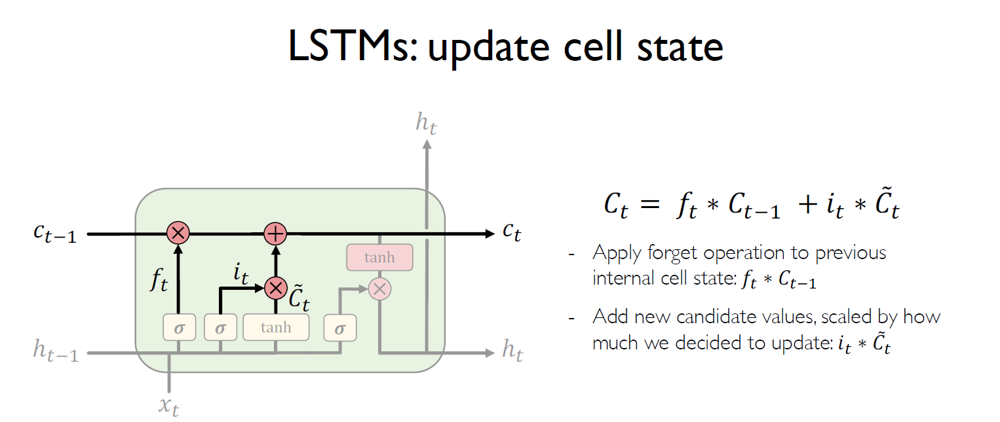

Slide 35
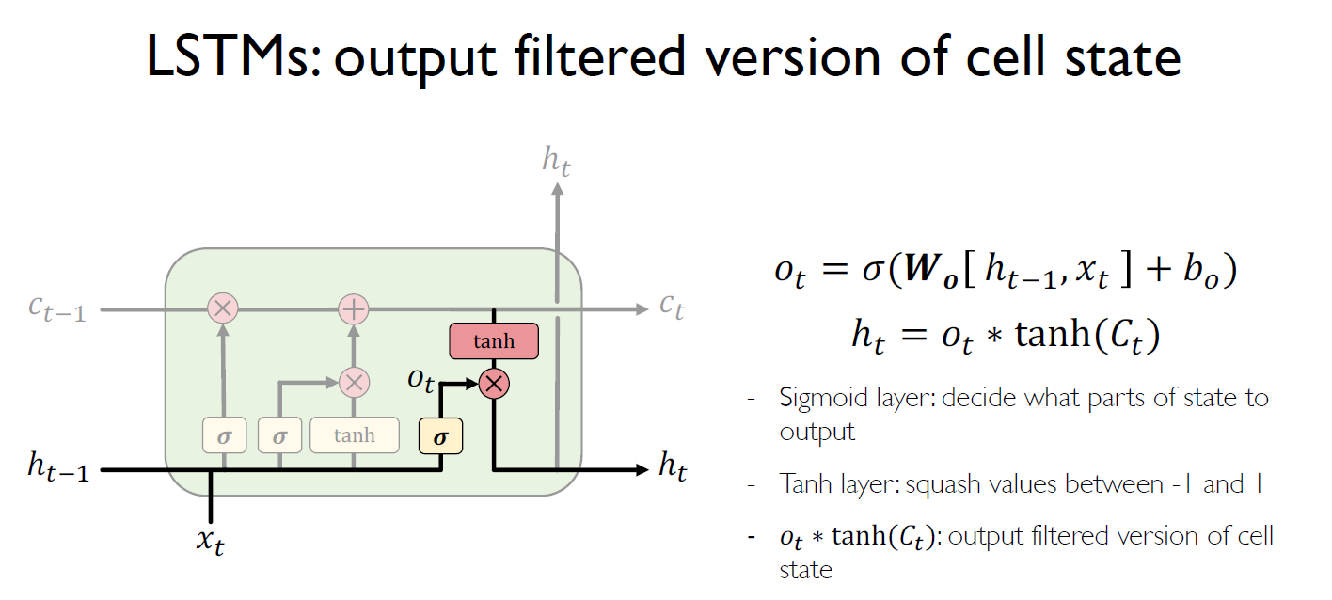
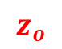
$$z_{o}$$

Slide 36
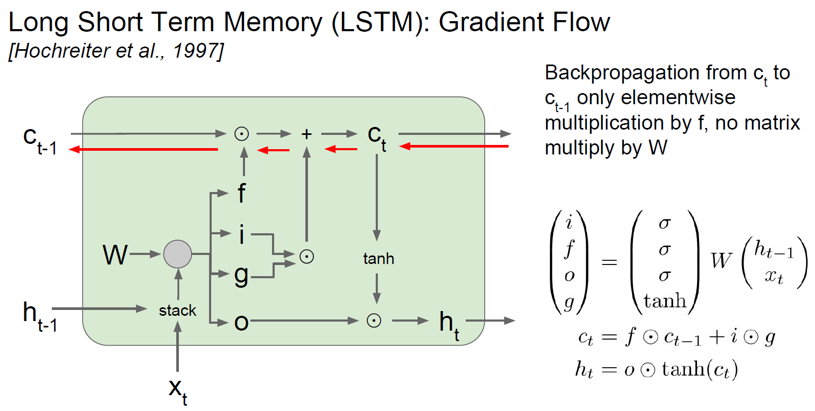

Slide 37
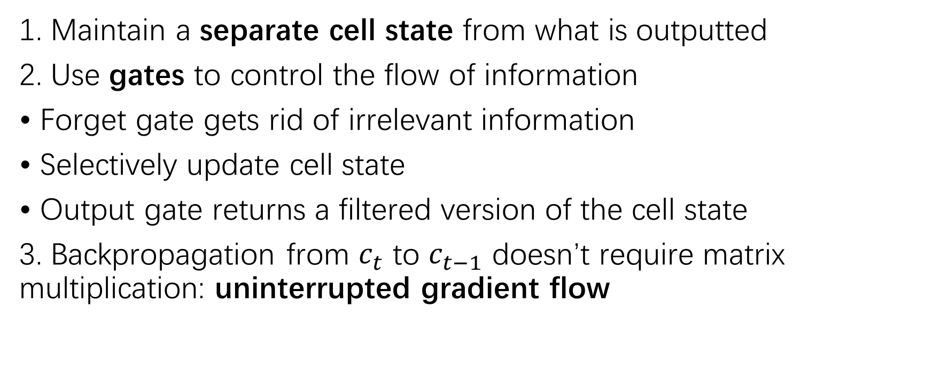
LSTM Key Points
1. Maintain a separate cell state from what is outputted
2. Use gates to control the flow of information
• Forget gate gets rid of irrelevant information
• Selectively update cell state
• Output gate returns a filtered version of the cell state
3. Backpropagation from $c_{t}$ to $c_{t−1}$ doesn’t require matrix multiplication: uninterrupted gradient flow

Slide 38
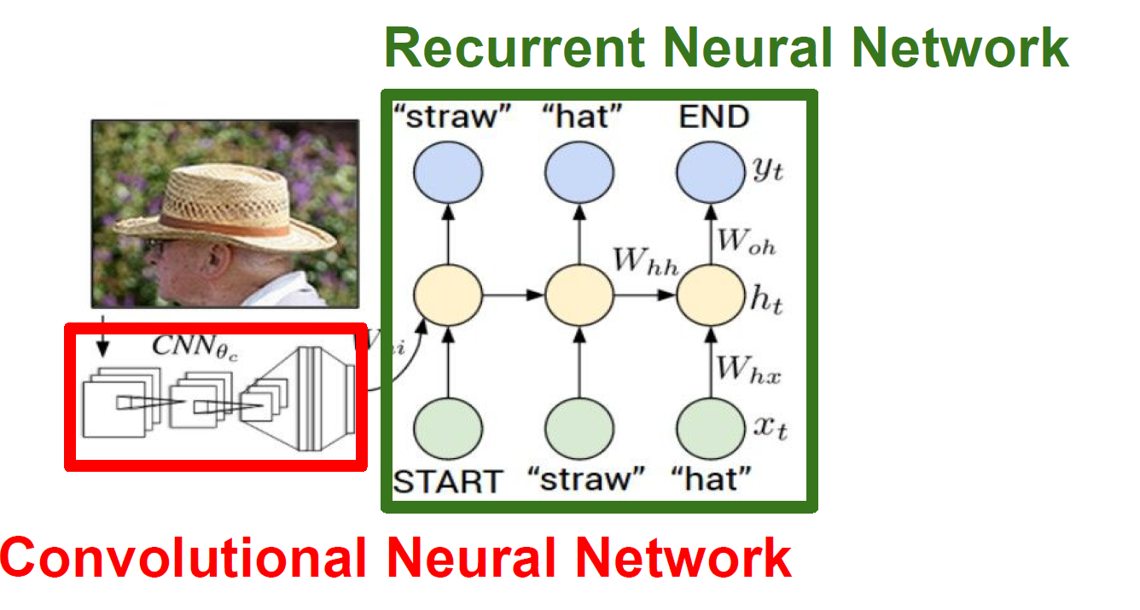
Application: Image Caption

Slide 39
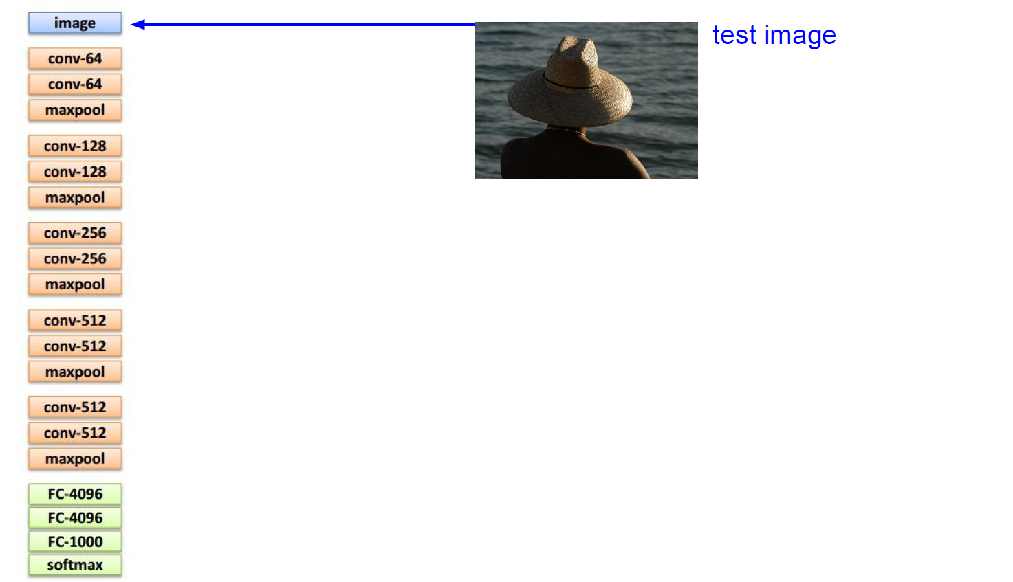
RECALL CNN

Slide 40
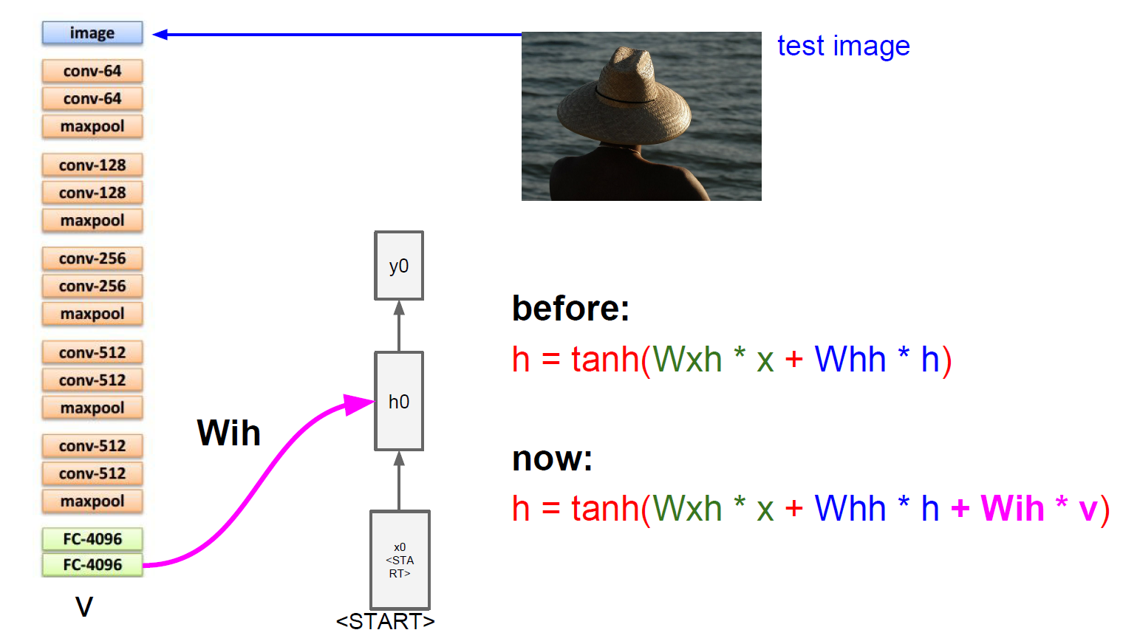
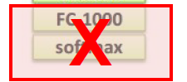
CNN + RNN

Slide 41
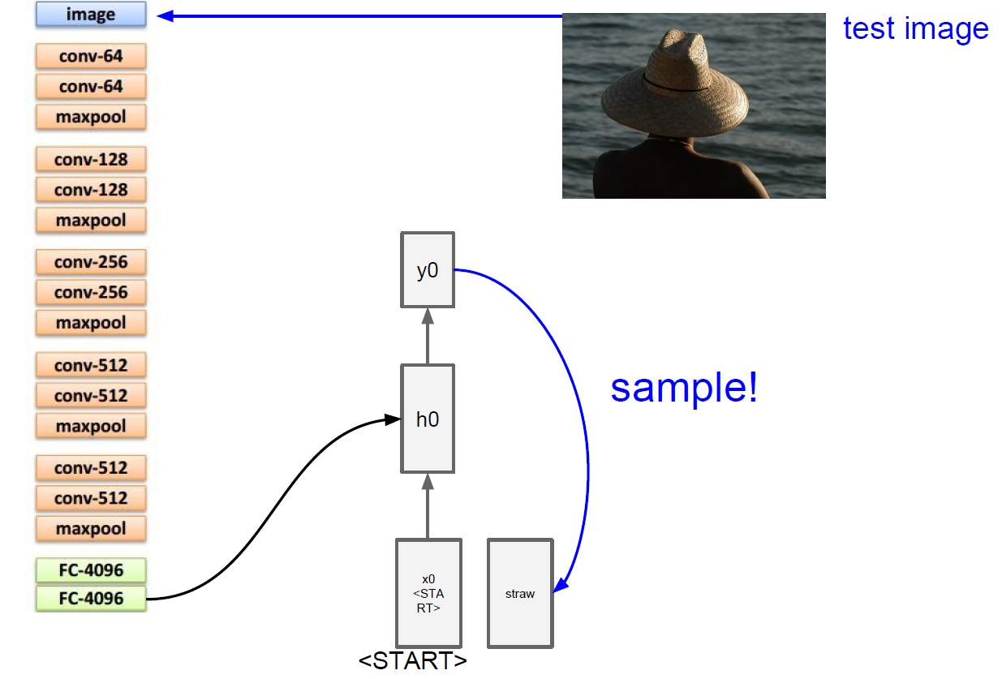
Image Caption

Slide 42
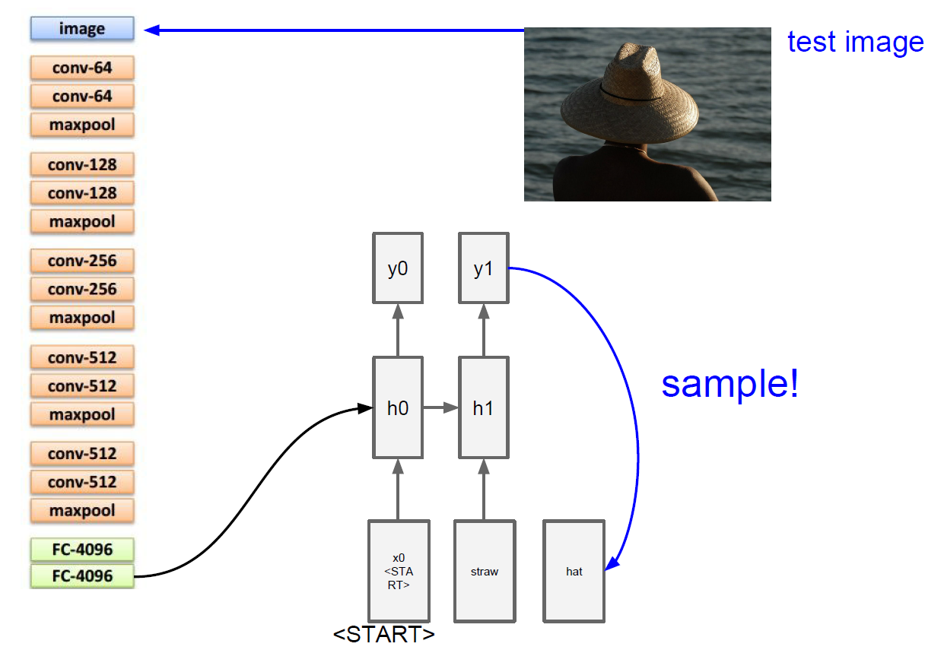
Image Caption

Slide 43
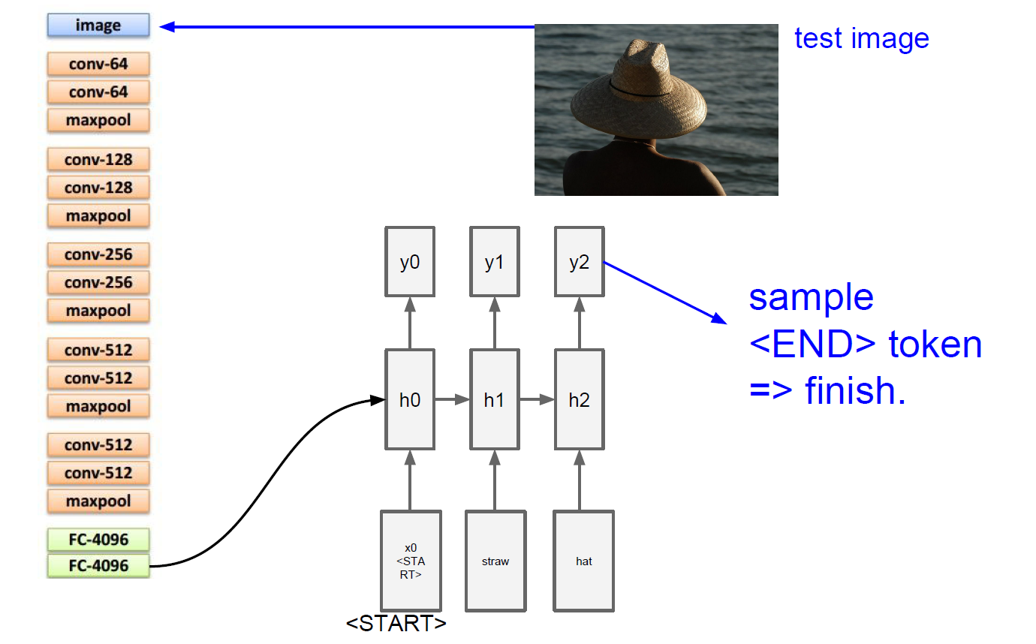
Image Caption

Slide 44
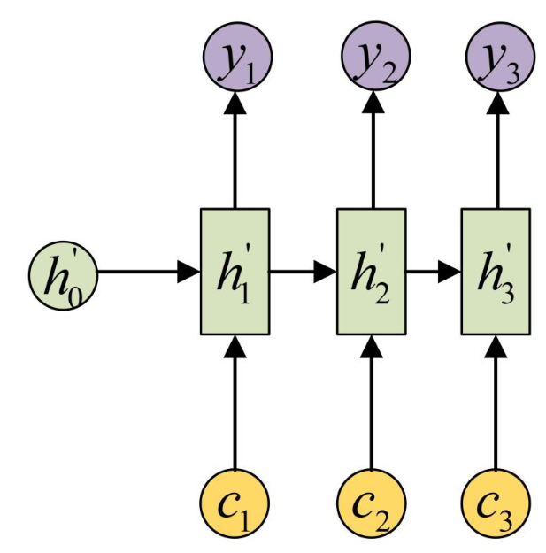
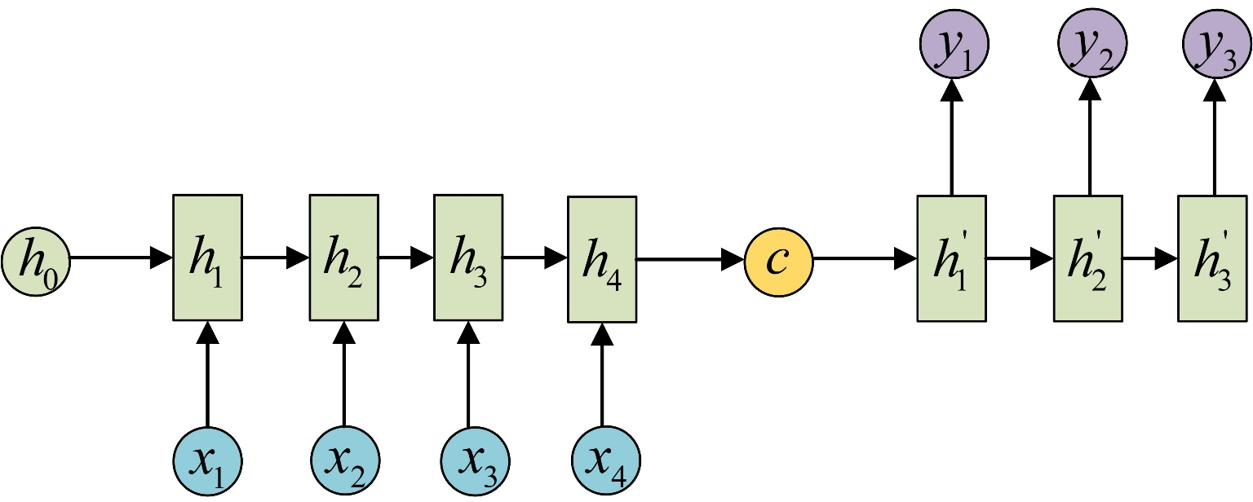
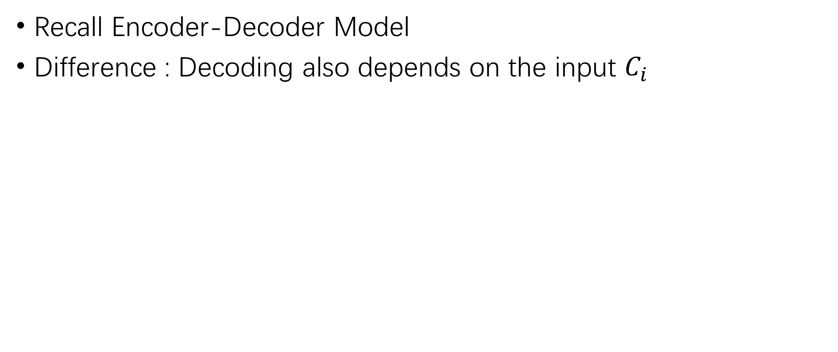
RNN with attention
Recall Encoder-Decoder Model
Difference : Decoding also depends on the input $C_{i}$
Notes:
对于Encoder中包含的输入内容的信息，attention机制会根据当前的输出，对Encoder中获得的输入做一个权重分配。这一点和 人类的注意力也很像。当人在翻译句子中某个词的时候，肯定也会有所针对的看原句中的对应部分，而不是把原句所有词都同等看待。

Slide 45




Example
Notes:
https://zhuanlan.zhihu.com/p/28054589

Slide 46

Image Caption With Attention

Slide 47

Image Caption With Attention

Slide 48

Image Caption With Attention

Slide 49

Visual Question Answering

Slide 50


